Slide 1


DBMS - Oracle SQL Developer
Free, integrated development environment which simplifies the development and management of Oracle Database in both traditional and Cloud deployments.
Components:
End-to-end development of PL/SQL applications
Worksheet for running queries and scripts
DBA Console for managing the database
Reports interface
Complete data modeling solution
Migration platform for moving any third party databases to Oracle

Slide 2
Methods of creating a new database schema
Using Service Console
Using Oracle SQL Developer
We used Oracle SQL Developer to create our schema
Using Oracle SQLcl
Using Oracle SQL*Plus
Steps to create a database schema using Oracle SQL developer:
Download and install Oracle SQL Developer: https://docs.oracle.com/en/cloud/paas/exadata-express-cloud/csdbp/connect-sql-developer.html#GUID-00D45398-2BF3-48D5-B0E9-11979D5EAFFC
Configure Oracle SQL Developer: https://docs.oracle.com/en/cloud/paas/exadata-express-cloud/csdbp/connect-sql-developer.html#GUID-00D45398-2BF3-48D5-B0E9-11979D5EAFFC
Connect with Oracle SQL Developer: https://docs.oracle.com/en/cloud/paas/exadata-express-cloud/csdbp/connect-sql-developer.html#GUID-238A40BD-10E9-4478-AAA3-43FC98519D3F

Slide 3
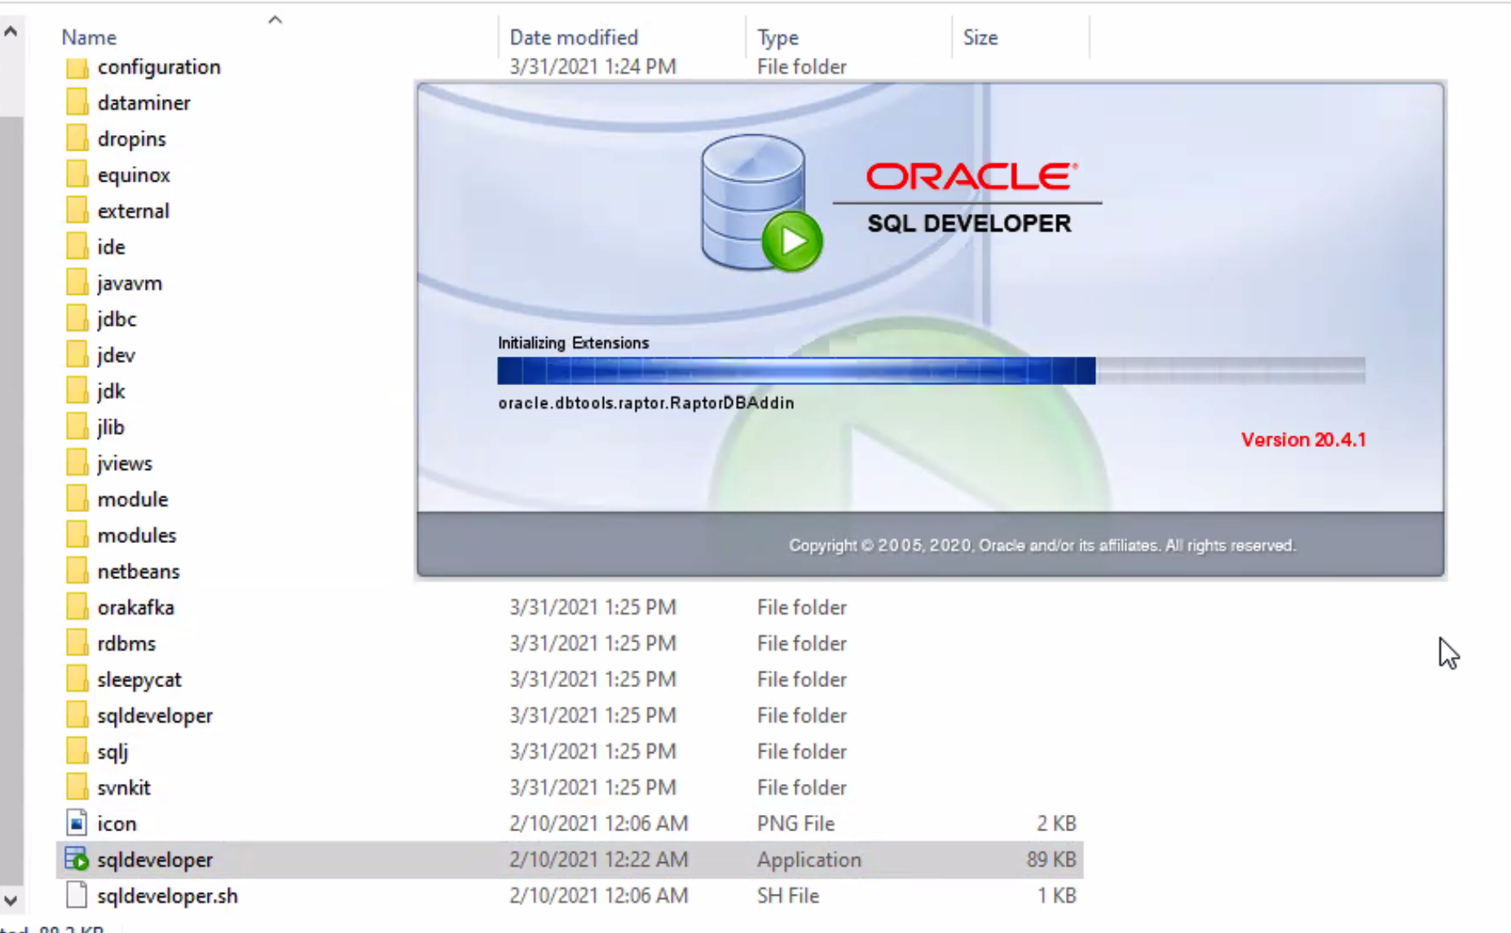
Tutorial- Accessing the database
Step 1: Launch the database:

Slide 4
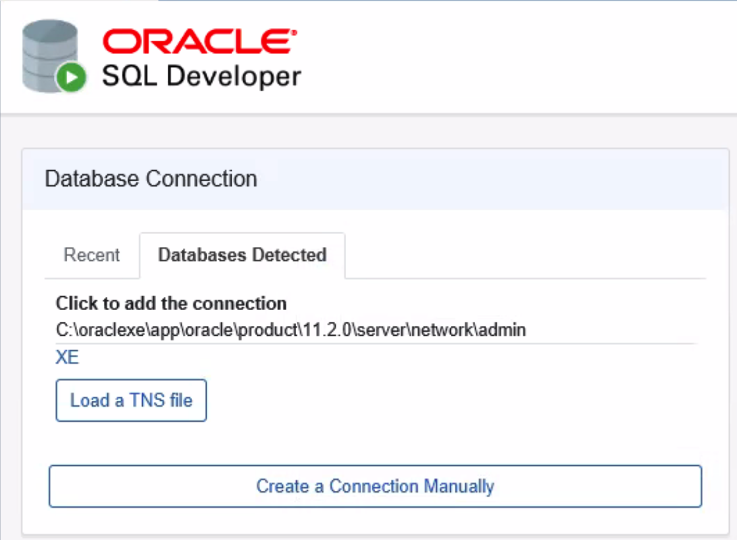
Step 2: Select the database schema you want to work on. Here we select XE. (In case you have to create a new schema, refer to the initial slides)

Slide 5
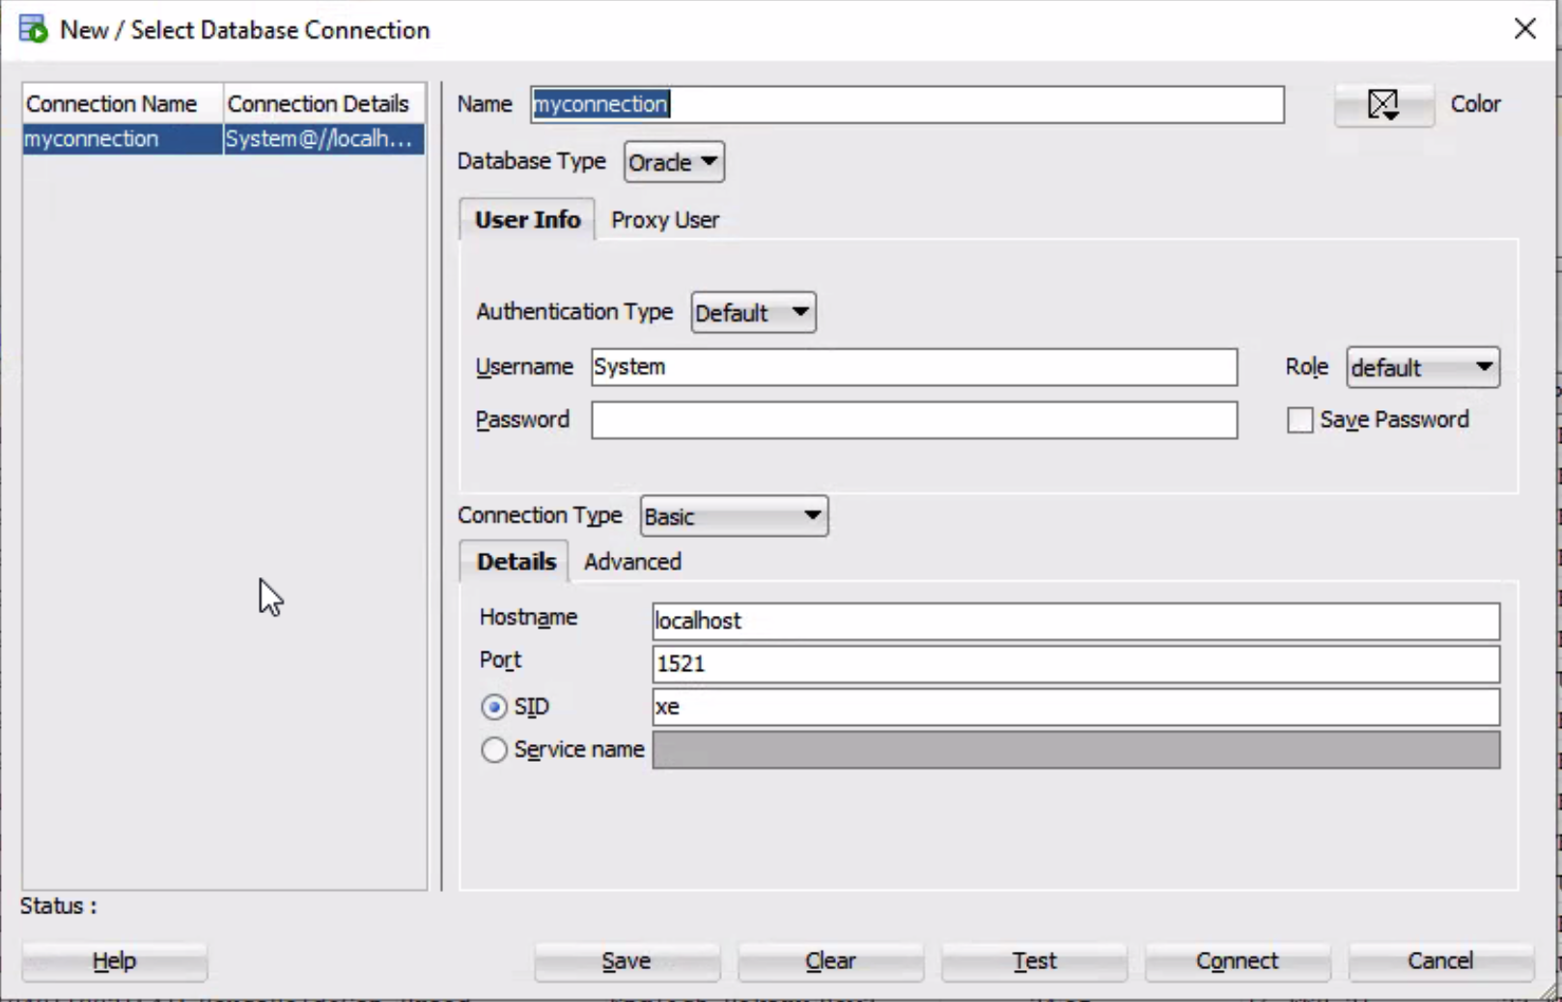
Step 3: Create a new Connection
While creating a new connection, the following was established:
Connection name is set as ‘myconnection’
Database type used is ‘Oracle’
We have set Username as ‘System’
Respective Hostname and Port numbers are generated
The SID is named as ‘xe’

Slide 6
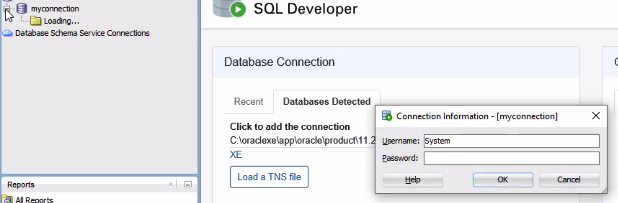
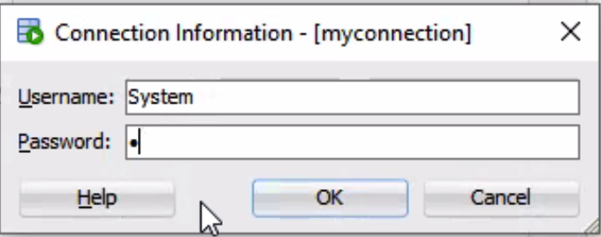
Step 4: Select the already established connection on the left pane. Here we select ‘myconnection’.
Step 5: Enter the username and password and click ‘OK’ :

Slide 7
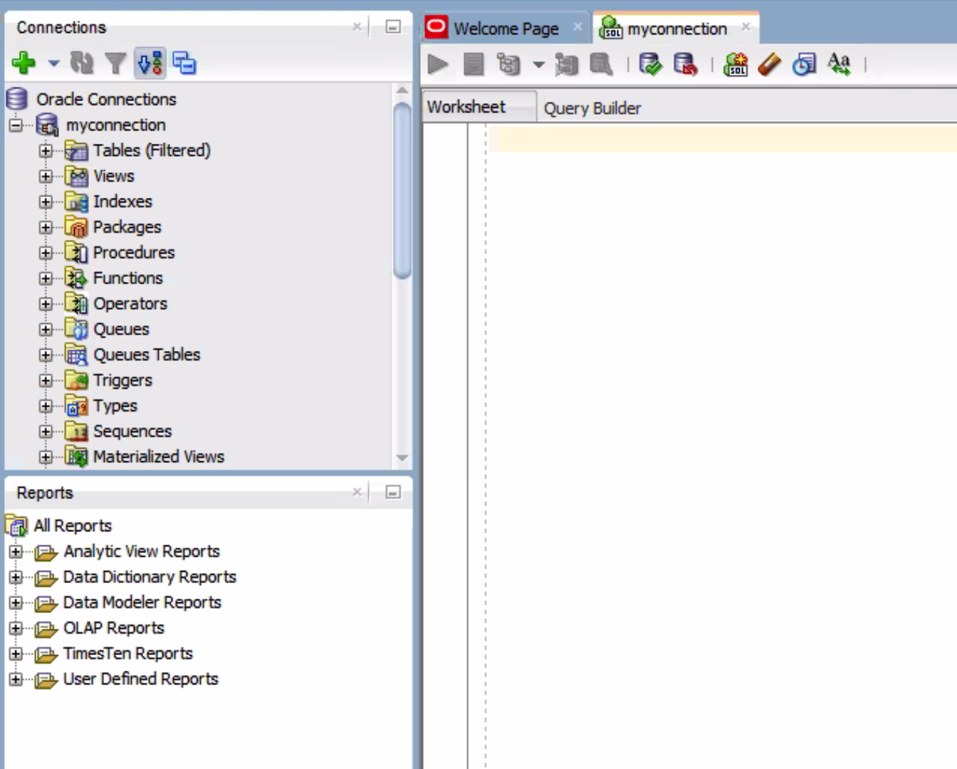
Step 6: The database is now ready to be used:

Slide 8
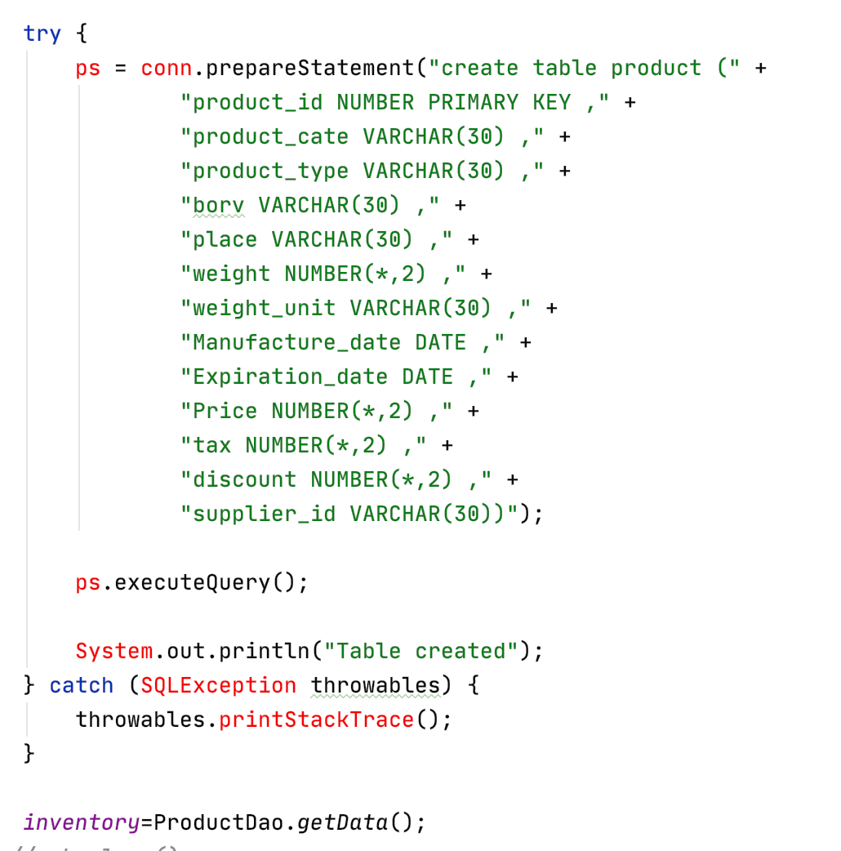
Creating database and schema
To create a schema: Create database XE;
Create table queries:
Product ID is defined as the primary key here
Data types have been defined for all attributes
Using getData function, the entire table is stored in a list that fetches, updates and deletes data in the database

Slide 9
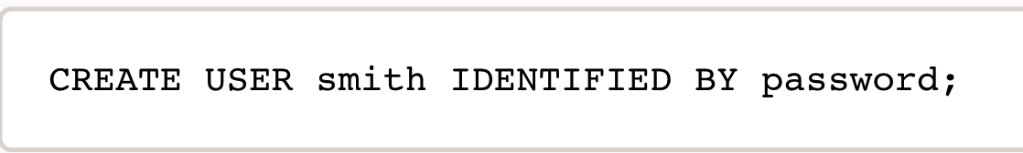
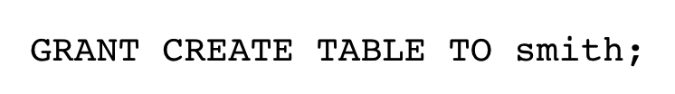
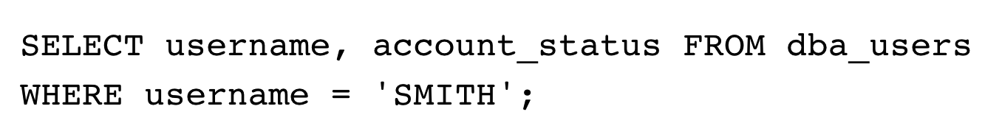
For creating multiple users to access, read and update the database, create users for the schema using the following query: Example for username ‘smith’ and password ‘password’:
Specific access rights can be granted to one or multiple users. Example:
Verify schema creation. Example:

Slide 10
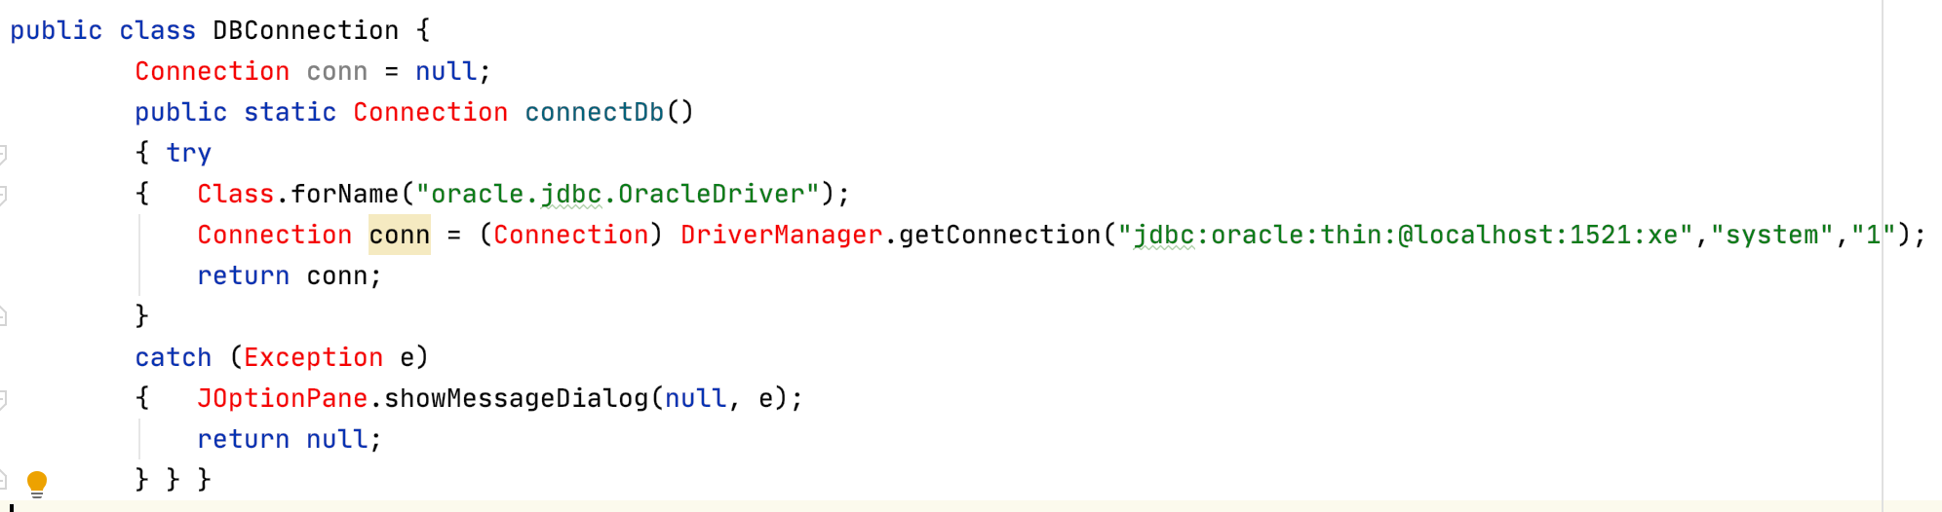
Establishing connections in the code
Creating Driver Manager connection
The method getConnection(String url) of Java DriverManager class attempts to establish a connection to the database by using the given database URL.
Connection is returned unless an exception occurs.

Slide 11
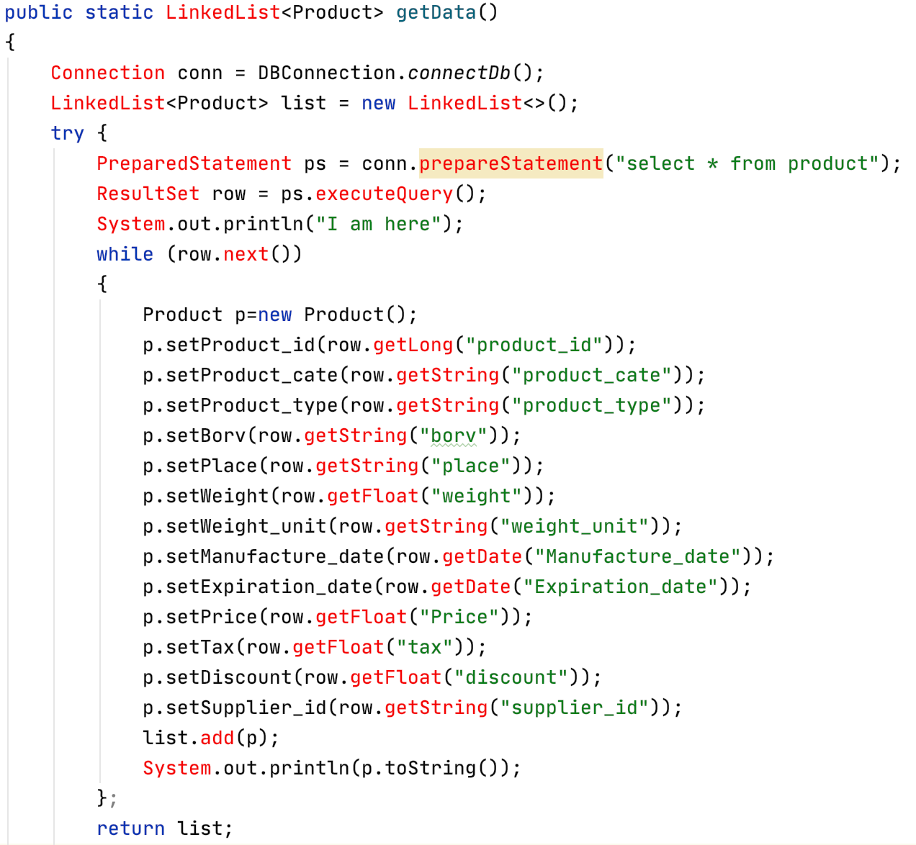
Get Data Functionality
A connection is established using connectDb function from DBConnection class.
PreparedStatament is an interface extended from Statement which stores a pre-compiled SQL query. It can execute the query multiple times. Here the ‘select * from statement’ is queries multiple times as and when the data is to be displayed.
All the data is fetched from the output and stored in the product object which is a linked list.
ResultSet is an interface which stores the output of a query. In this case, it stores the entire database.

Slide 12
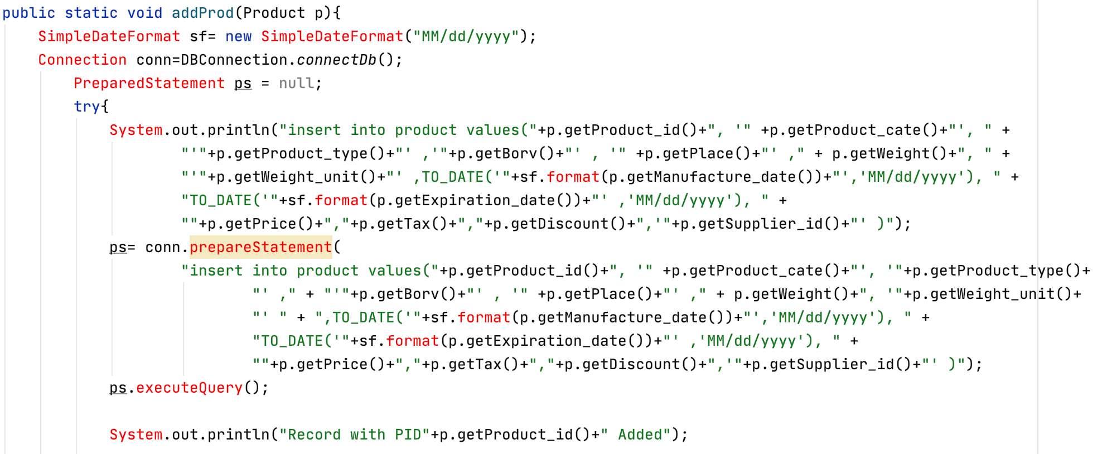
Add functionality
With the help of prepareStatement method we can insert values into the database. We are using ‘Insert into’ SQL query to do the same:

Slide 13
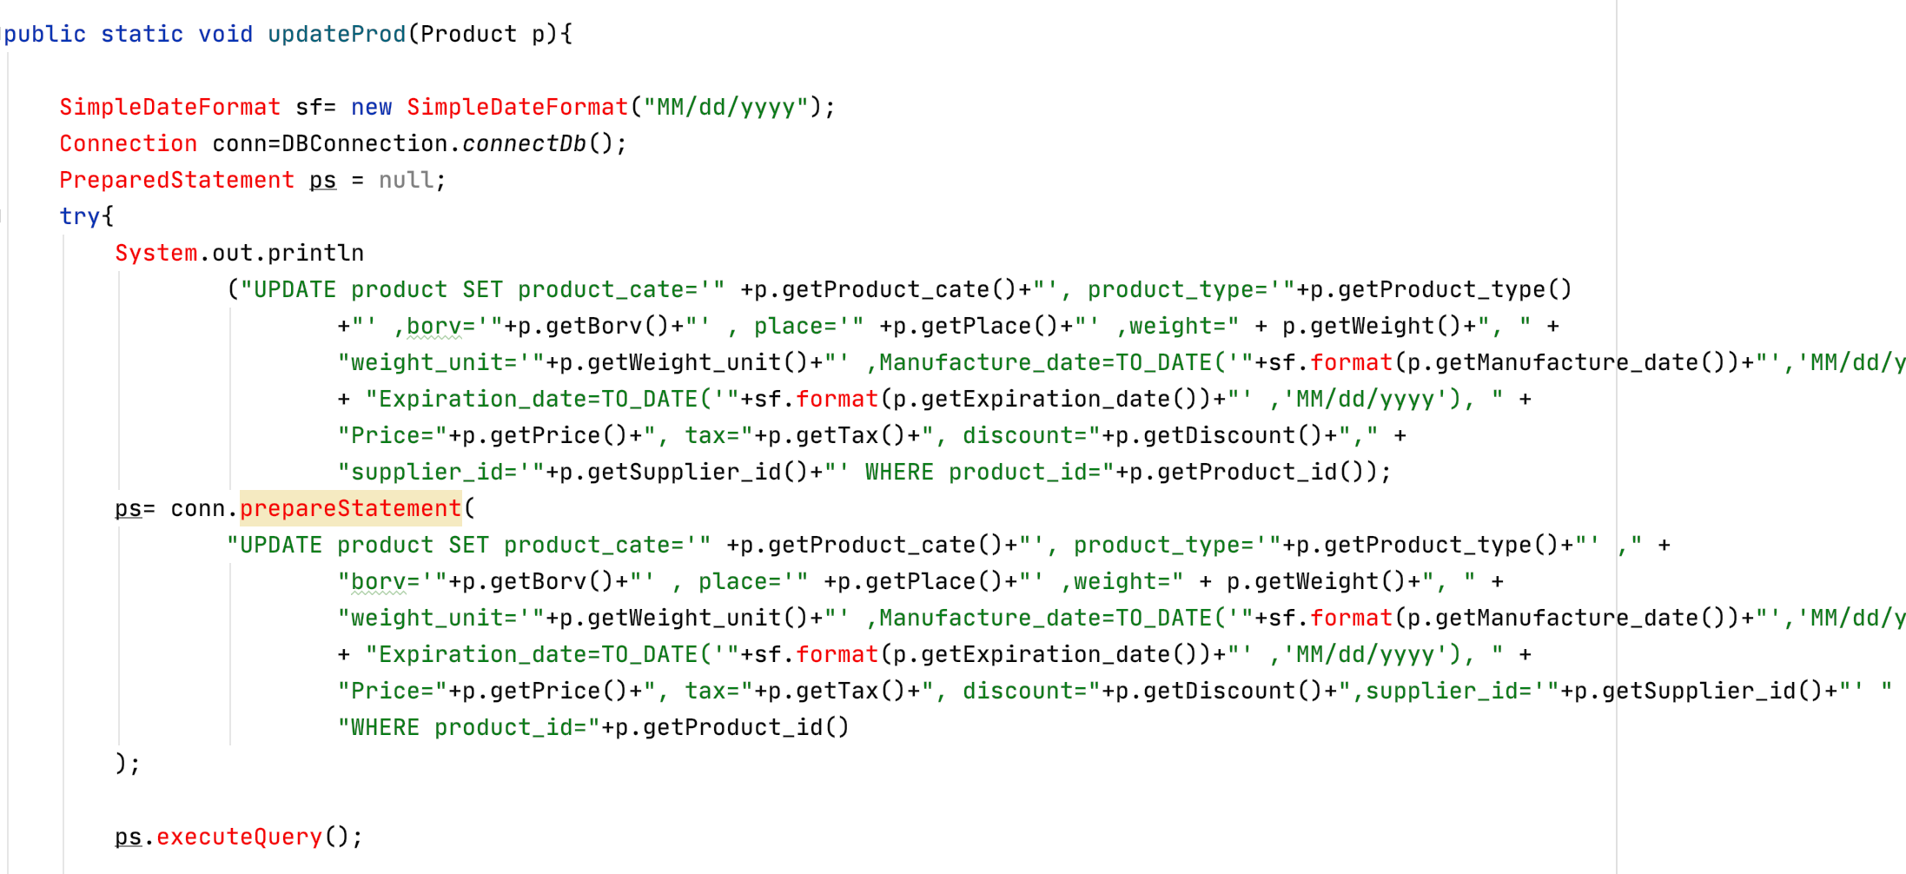
Update functionality
With the help of prepareStatement method we can update the product by searching for the product with the help of product id. Here we are using ‘Update’ SQL query to do the same.

Slide 14
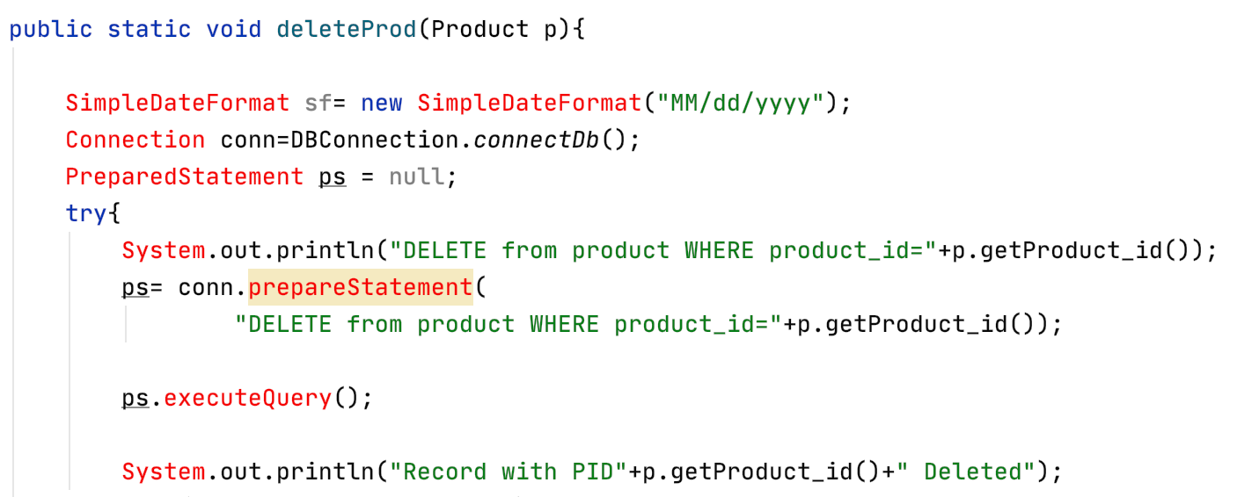
Delete functionality
With the help of preparedStatement method we can delete the product by searching for the product with the help of product ID. Here we are using ‘delete’ SQL query to do the same.

Slide 15
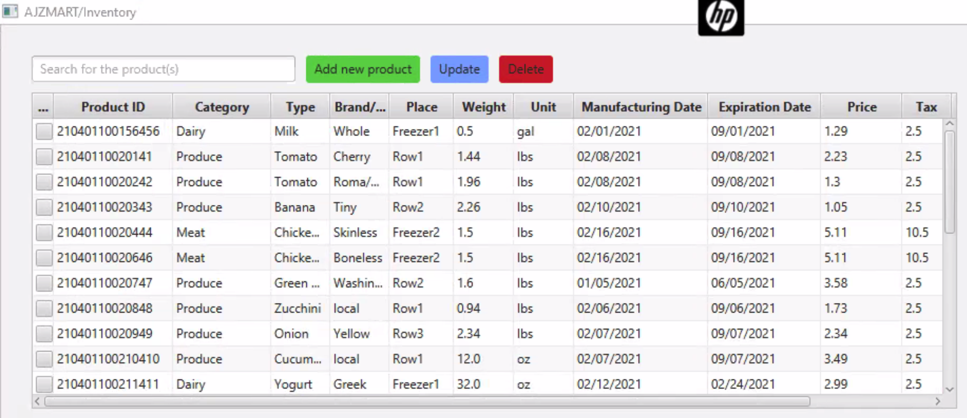
Comparing application functionalities with database updates
Functionality 1: Show all the products in the application:

Slide 16
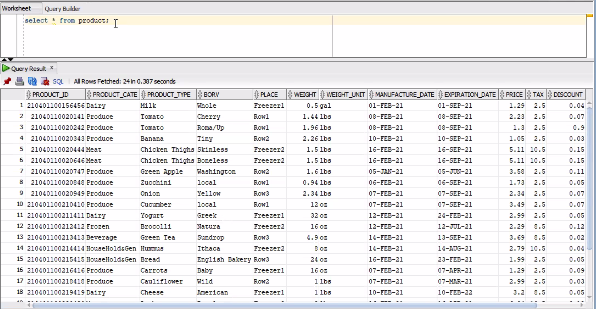
Functionality 1: Show all the products in the database:

Slide 17
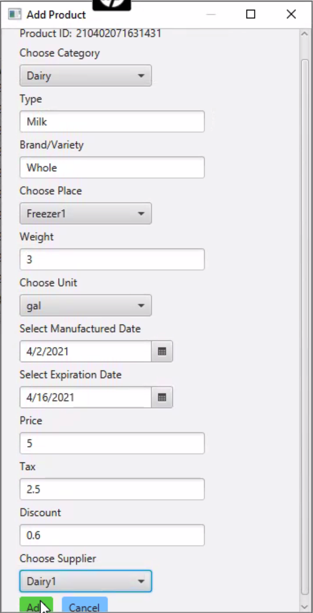
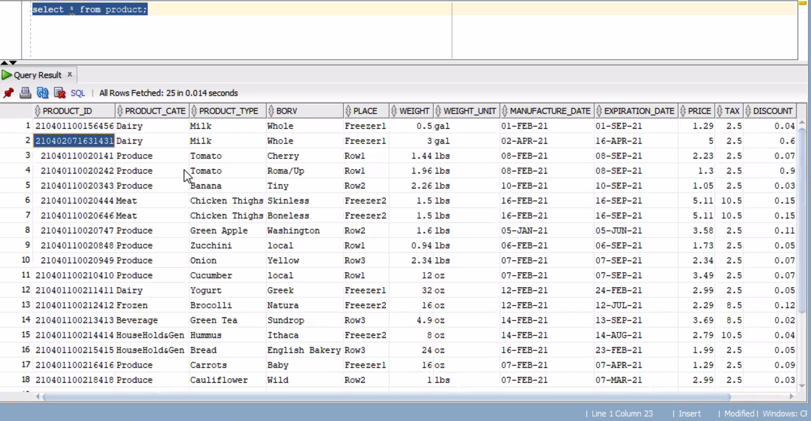
Functionality 2: Add a new product in the application and check result in ORACLE database

Slide 18
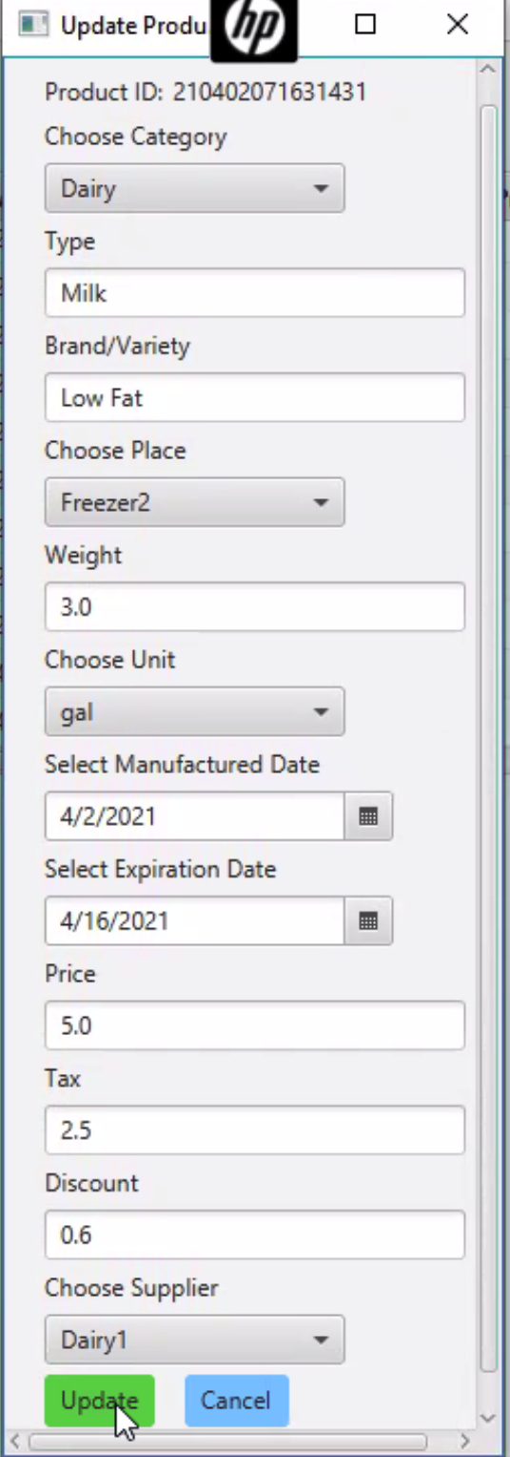
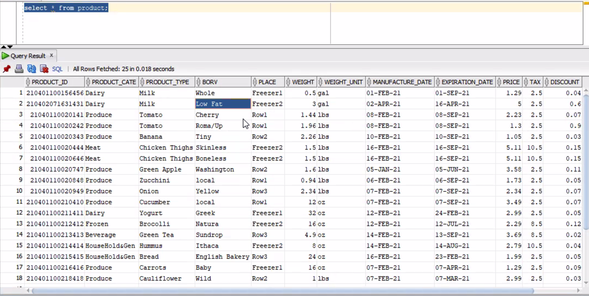
Functionality 3: Update a product in the application and check result in ORACLE database

Slide 19
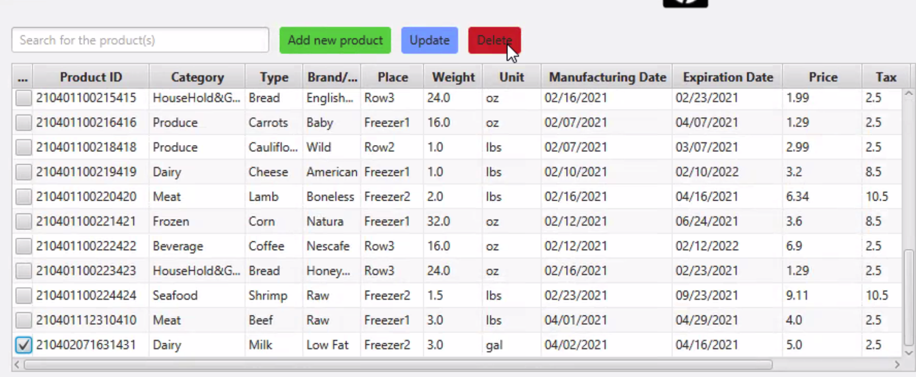
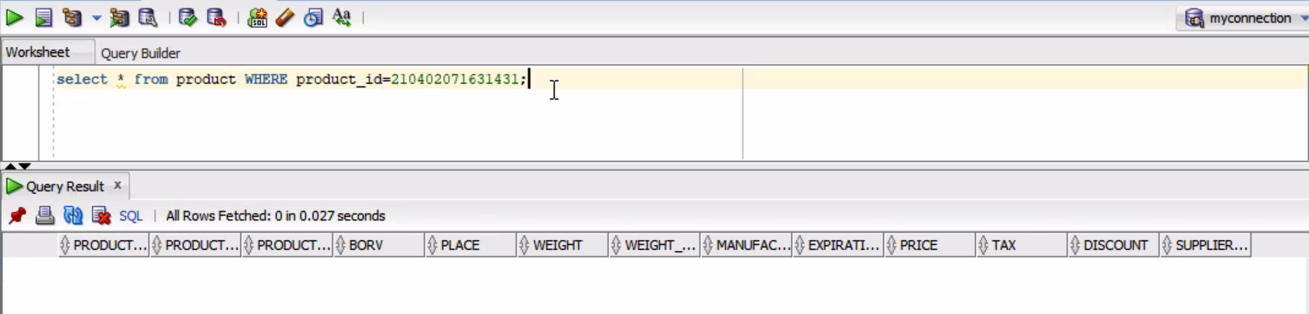
Functionality 4: Delete a product with ID ‘210402071631431’ in the application:

Slide 20
Thank you!

